Slide 1
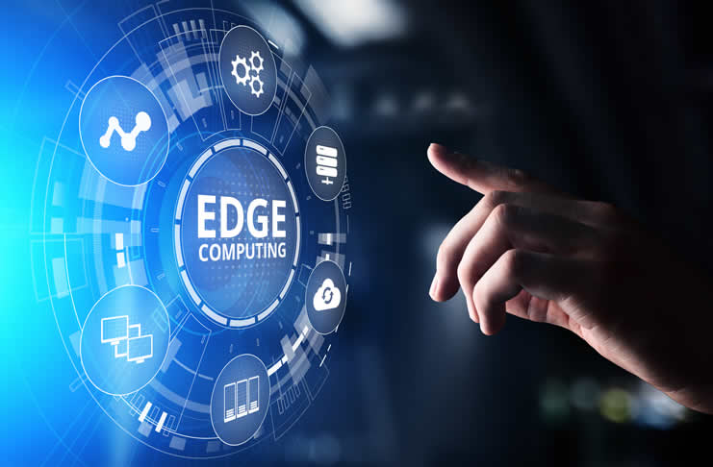

Slide 2
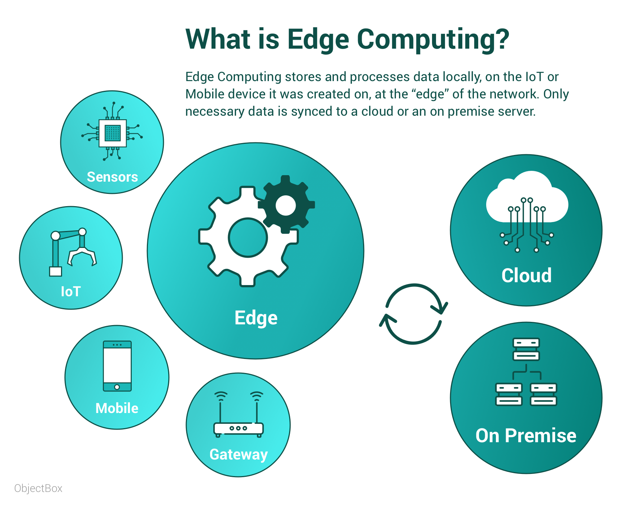

Slide 3
Overview of Edge Computing
Edge Computing is a distributed computing paradigm in which processing and computation are performed mainly on classified device nodes known as smart devices or edge devices as opposed to processed in a centralized cloud environment or data centers.
It helps to provide server resources, data analysis, and artificial intelligence to data collection sources and cyber-physical sources like smart sensors and actuators.

Slide 4
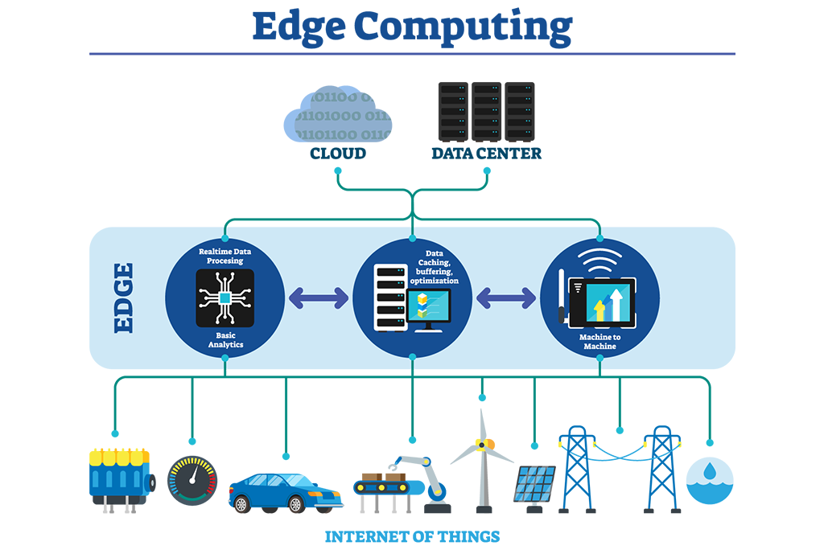

Slide 5
What exactly is Edge Computing according to research firms?
A network of micro data centers that store or process critical data locally and push received data to a centralized data center or repository of cloud storage.
Typically in IoT use cases, a massive chunk of data goes through the data center, but edge computing processes the data locally results in reduced traffic in the central repository.
This is done by IoT devices, transferring the data to the local device, which includes storage, compute, and network connectivity.
After that, data is processed at the edge while another portion is sent to storage repository or central processing in the data center.

Slide 6
Why is Edge Computing Important?
New Functionalities are offered.
Easier configurations.
Hacking Potential is increased.
The load on the server is reduced.
Load on Network is reduced.
Application Programming Interface.
Increases Extensibility.
Centralized Management.
Costs of Licensing.
Support and Updates.

Slide 7
Is edge computing seen as necessary?
In the realization of physical computing, smart cities, computing, multimedia applications such as augmented reality and cloud gaming, and the Internet of Things (IoT).
It is a way to streamline the movement of traffic from IoT devices and implement real-time local data analysis.
Data produced by the Internet of Things (IoT) devices to be processed where it is created instead of taking away to the routes to data centers with the help of edge computing.
It also benefits Remote Office/Branch Office (ROBO) environments and organizations that have dispersed user base geographically.

Slide 8
Edge Computing Terms and Definitions
Edge
It highly depends on the use cases.
Like in telecommunication, it may be a cell phone or cell tower.
Similarly, in the automotive example, it could be a car.
In manufacturing, it could be a machine, and
In the Information Technology field, it could be a laptop.
Edge Devices
A device which produces data is edge devices like machines and sensors, or any devices through which information is collected and delivered.

Slide 9
Edge Gateway
It’s a buffer where edge computing processing is done.
The gateway is the window into the environment beyond the edge of the network.
Fat Client
It’s a software that processes data in edge devices, which is opposite to thin client, which hardly transfers data.
Edge Computing Equipment
Devices like sensors and machines can be outfitted to work in edge computing.
Environments by making the internet accessible.
Mobile Edge Computing
It signifies the growth of edge computing systems in telecommunication systems like 5G scenarios.

Slide 10
Edge Computing Architecture
Cloud Modules Legacy Cloud Apps Edge Run time Cognitive, Storage, Analytics | Cloud
Edge Modules Gateway Services | Gateway

Slide 11
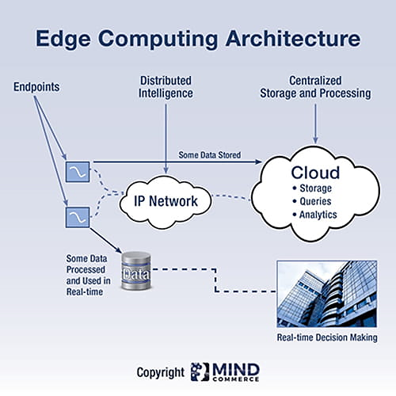

Slide 12
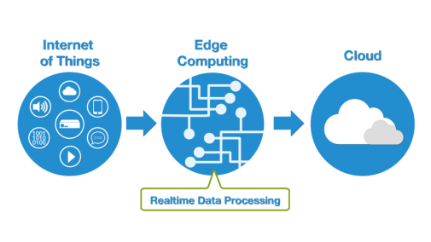
Internet of Things (IoT) and Edge Computing
In IoT, with the help of edge computing, intelligence moves to the edge.
There are various scenarios where speed and high-speed data are the main components for management, power issues, analytics, and real-time need, etc. helps to process data with edge computing in IoT.

Slide 13
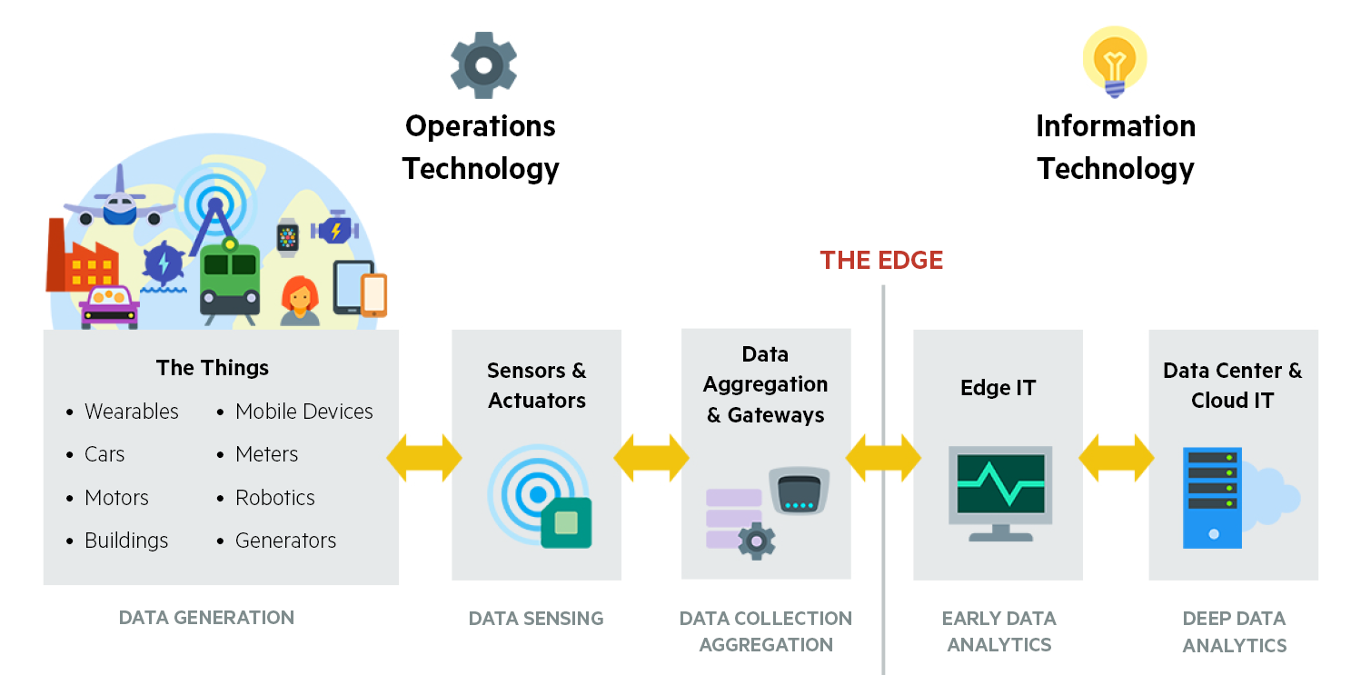

Slide 14
Benefits of Enabling Edge Computing for the Internet of Things (IoT)
Lesser Network Load
Zero Latency
Reduced Data Exposure
Computational Efficient
Costs and Autonomous Operation
Security and Privacy

Slide 15
Future Directions of Computing for the Internet of Things (IoT)
Edge-to-Cloud data exchange capabilities
Common-on-Edge data exchange capabilities
Streaming Data Analytics and Batch frameworks and APIs
Controlled rolling and Versioning upgrades of applications
Status of application monitoring from an Ad-Hoc Cloud Dashboard
Cloud-Based Deployments of Edge Computing Applications

Slide 16
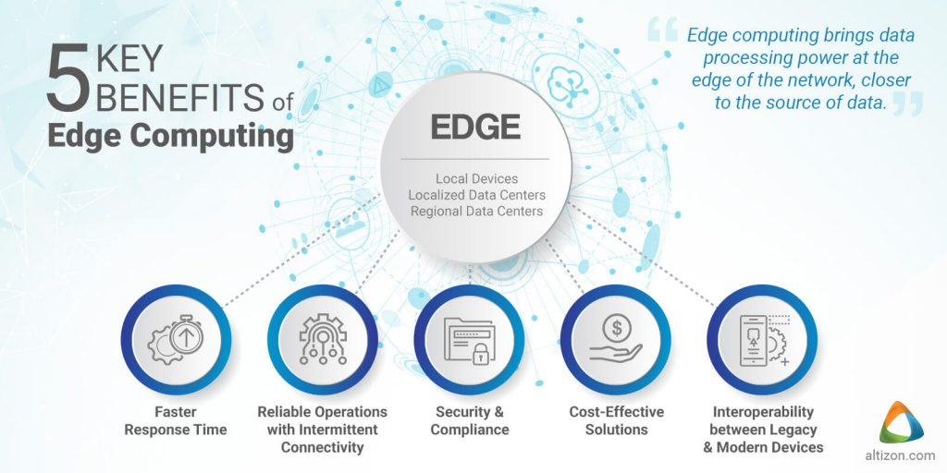

Slide 17
Advantages of Enabling Edge Computing
Speed is increased.
Reliability is increased.
The random issue is reduced.
The compliance issue is reduced.
Hacking issues are reduced.
Random issues are reduced.

Slide 18
Edge Gateway Server
Real-Time Analytics
Transactional analytics
Business Intelligence
No Latency Issue
Medium Latency Requirements
Low Latency Requirements

Slide 19
Cloud Computing vs. Edge Computing vs. Fog Computing
Edge Computing and Fog Computing are the extensions of Cloud Networks, which are a collection of servers comprising a distributed network.
Such networks allow organizations to exceed the resources that would be otherwise available to them.
The main advantage of cloud networks is that they allowed data to be collected from multiple sources, which is accessible anywhere over the internet.
While Fog Computing and Edge Computing are almost similar, where the talk about intelligence and processing of data at the time of creation.
Fog Computing focus more on intelligence at local area network and this architecture transmits data from endpoints to a gateway where it is sent to sources for processing and return to transmission
while Edge Computing focus more on computing power and processing of data locally at the edge of a network.
It performs processing on embedded computing platforms interfacing to sensors and controllers.

Slide 20
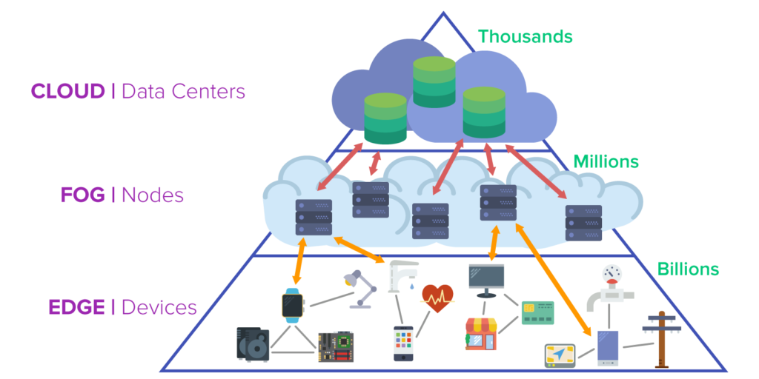

Slide 21
Cloud Layer
Big Data Processing
Data Warehousing
Business Logic
Fog Layer
Local Network
Data Analysis and Reduction
Standardization
Edge Layer
Large Volume Real-Time Data Processing
On premises Data Visualization
Embedded Systems
Gateways
Micro Data Storage

Slide 22
Security in Edge Computing
There are two sides of security in edge computing –
One of them is that the security in edge computing is better than any other part of the data storage application because data is not traveling over the network; it stays where it is created.
The flip side of it is that security in edge computing is less secure because the edge devices in themselves can be more vulnerable.
In conclusion, data encryption, access control, and the use of virtual private networks are crucial elements to protect the edge computing system.

Slide 23
Use Cases where Edge Computing becomes critical
Having low latency, e.g., Closed-loop interaction between machine insights.
For real-time analytics, access to temporal data.
Low connectivity, e.g., Remote Location.
The high cost of transferring data to the cloud.
Bandwidth.
Cybersecurity constraints.
Compliance and Regulation.
The immediacy of Analysis, e.g., To check machine performance.
Predictive Maintenance.
Energy Efficiency Management.
Flexible Device Replacement.

Slide 24
Why Edge Computing Matters?
When IoT devices have poor connectivity.
Not efficient for IoT devices to be in constant touch with the central cloud.
The latency factor reduces latency because data doesn’t have to traverse over a network to a central cloud for processing.
Where latencies are untenable like manufacturing or financial services.
As soon as data is produced, it doesn’t need to send over a network; instead, it compiles the data and sends daily reports to the cloud for long term storage, i.e., reduces the data traversing.
The buildout of the next-generation 5G cellular networks by telecommunication companies.
Direct access to gateway into the telecom provider’s network, which connects to a public IaaS cloud provider.

Slide 25
Use of Edge Computing related to Industries
Smart applications and devices respond to data, instantly eliminating lag time.
Real-time data process with any latency where even milliseconds in latency make a difference in the processing of data.
Acceleration in the data stream.
Efficient data processing in massive data.
Effective use of the application in a remote location.
Security for sensitive data even without putting in the public cloud.

Slide 26
Role of Edge Computing in Healthcare
As we know, edge allows us to manage your connectivity and disperse processing closer to where data is, the advantage is a natural evolution when you optimize some part of your stack in the network with giving more localized services for your application.
Moving the analysis of clinical information to edge computing is crucial for healthcare organizations that want to benefit from going digital and the key to digital healthcare problems.
For example, in the hospital, we collect data from IoT devices, which is monitoring patients and transfer it to the trust’s electronic health record (EHR) from the bedside, with the authentication of staff to the IoT devices through proximity cards.

Slide 27
Role of Edge Computing in Social Good
Environmental factors like road traffic density, air quality, weather, school holidays, and other open data sets give better results by the processing of data with the help of edge computing and machine learning.
The computing power will apply these factors to the data collected from healthcare at the point of admission, where data to be set where the patient expected to be discharged.
There is also a movement from businesses in all sectors to use edge computing.

